Slide 1
SHHH! IT’S A SECRET!
Secrets Management for the Modern Tech. Pro
Andy Syrewicze
linkedin.com/in/asyrewicze
1 / 15

Slide 2
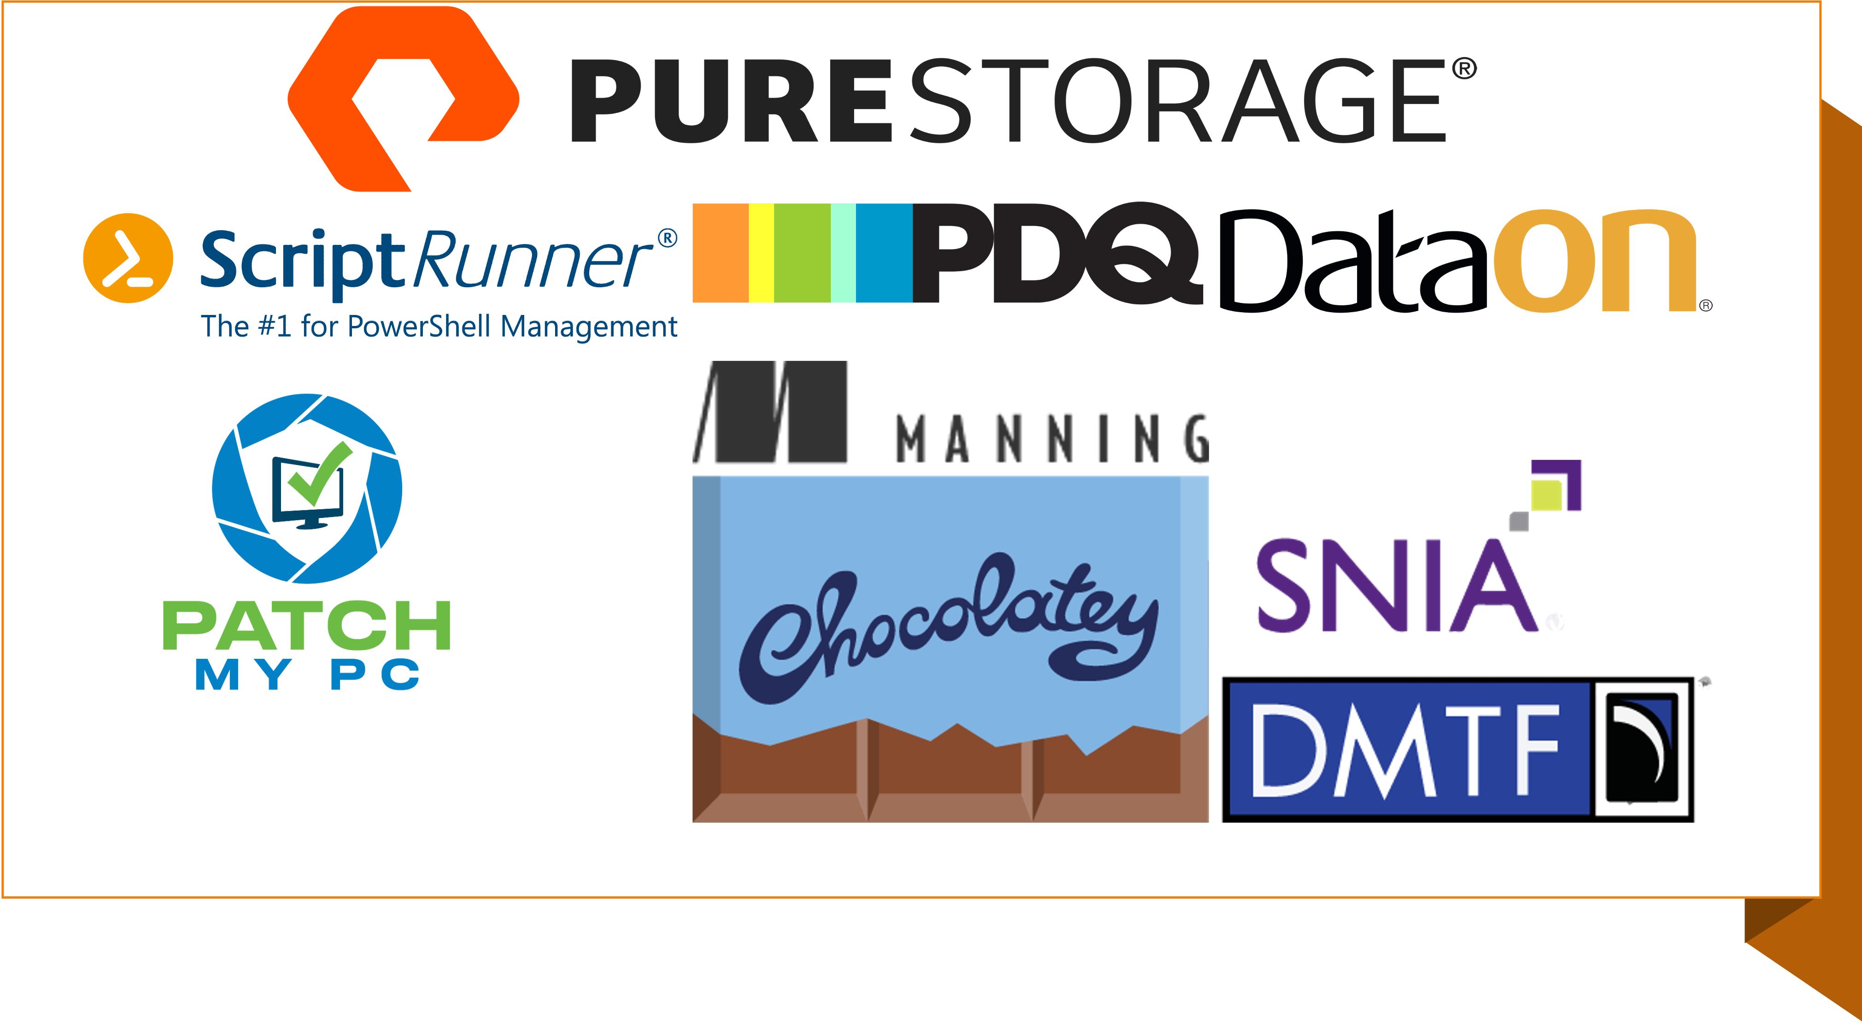

Slide 3
Get-SessionContext!
Introductions
Some BAD examples
Working with Key Vault and Key Vault Firewall
System Account Managed Identities
NOTE: The focus is getting secrets to and from our scripts

Slide 4
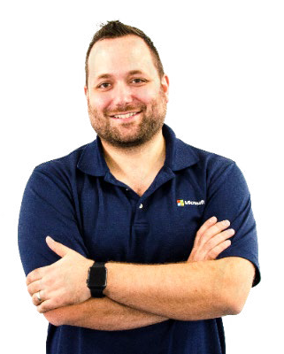

Andy has been in the IT Industry for more than
20 years, is a Microsoft Cloud and Datacenter Management MVP, and currently a Security Evangelist for Hornetsecurity.
Andy Syrewicze
Security Evangelist
Microsoft CDM MVP
LinkedIn – linkedin.com/in/asyrewicze

Slide 5
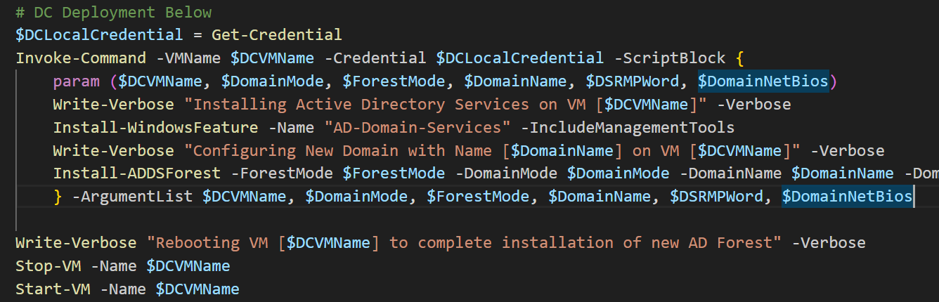
What’s Wrong Here?

Slide 6
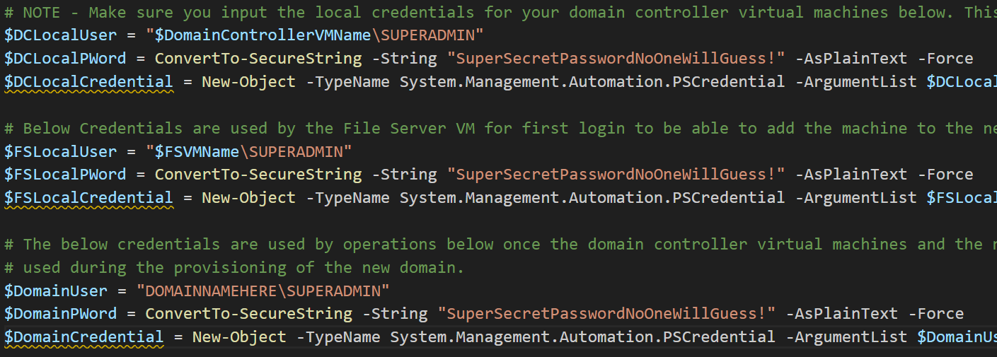
Or this one?

Slide 7
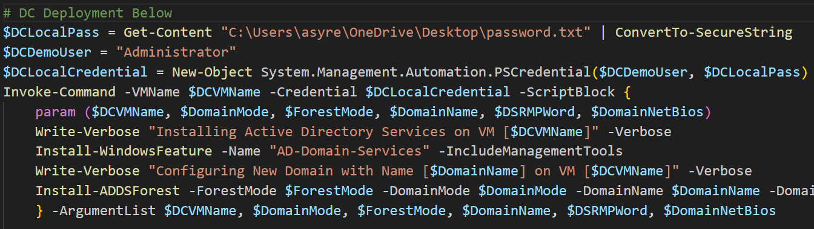
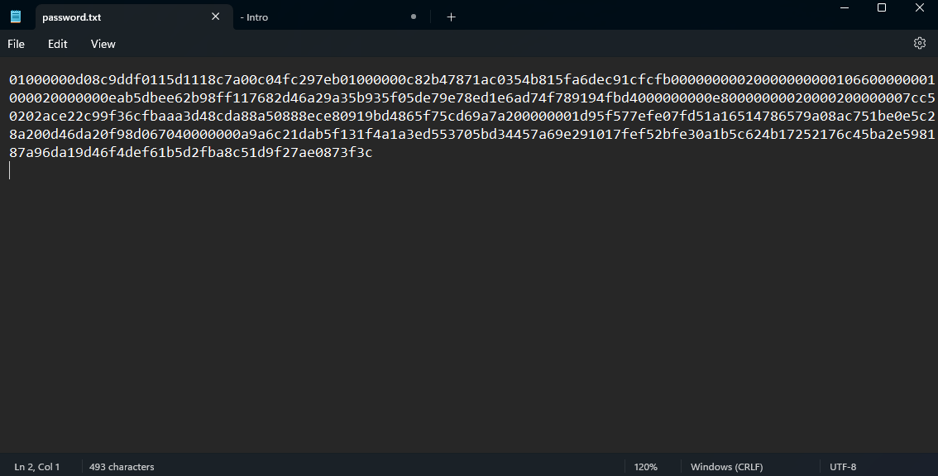
How about this one?

Slide 8
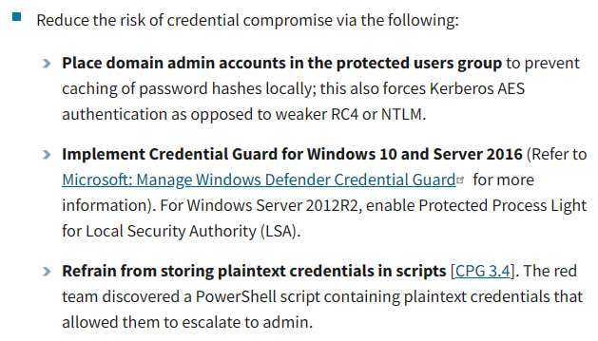
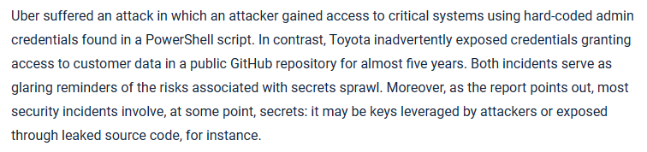
The Problem
https://www.cisa.gov/news-events/cybersecurity-advisories/aa23-059a
Attackers will take advantage of haphazardly stored passwords
Password files can be broken
Password prompting can go against zero-trust computing and principal of least privilege
https://thehackernews.com/2023/05/the-rising-threat-of-secrets-sprawl-and.html

Slide 9
What do we Need?
Secrets need to be:
Securely Stored
Isolated within Security Boundaries
Monitored and Reported
Be Protected from Negligent or Malicious Action

Slide 10
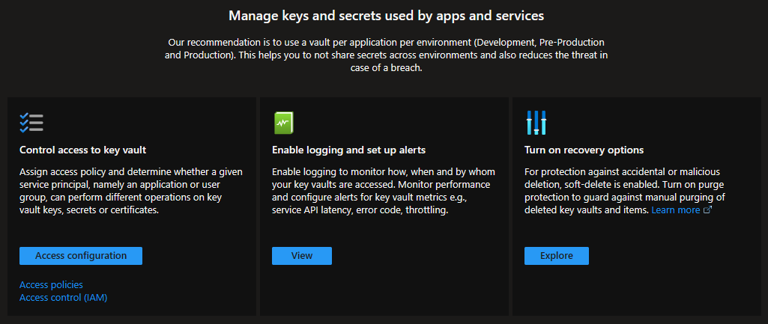
Azure Key Vault

Slide 11

Iz Do Demo?
Azure Key Vault Demo

Slide 12
So that’s cool and all…. But we’ve accidentally created another problem…

Slide 13



Dude! Gimme those Creds!
You need to authenticate first… “dude”
You were supposed to solve the password issue! Not Create One!
Secret’s Transmission
Script
Key Vault

Slide 14
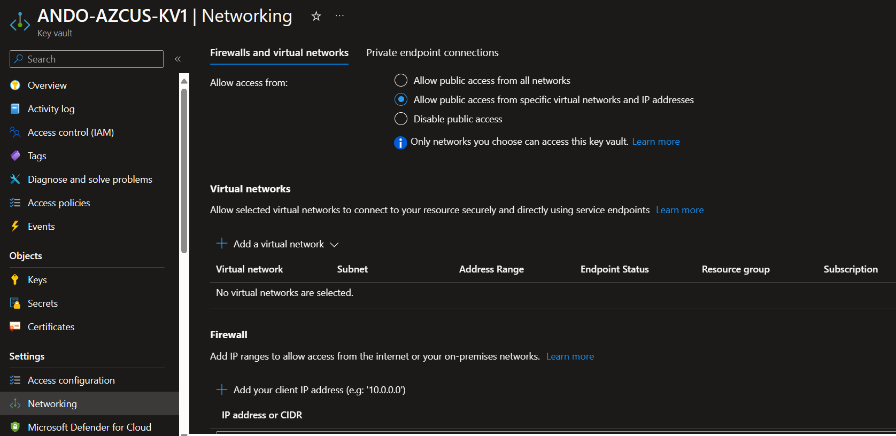

Slide 15
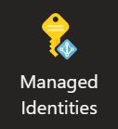
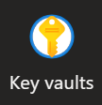
Key Vault Access with Managed Identity
RBAC

Slide 16
Managed Identity Types
System Account Managed Identity
User Account Managed Identity

Slide 17
Iz Do Demo?
SAMI via Arc Enabled Server Demo

Slide 18

Security Swarm!

Slide 19
Resources
https://www.cisa.gov/news-events/cybersecurity-advisories/aa23-059a
https://thehackernews.com/2023/05/the-rising-threat-of-secrets-sprawl-and.html
https://learn.microsoft.com/en-us/azure/key-vault/secrets/quick-create-powershell
https://learn.microsoft.com/en-us/azure/key-vault/general/network-security
https://learn.microsoft.com/en-us/entra/identity/managed-identities-azure-resources/overview
https://learn.microsoft.com/en-us/entra/identity/managed-identities-azure-resources/tutorial-windows-vm-access-nonaad
https://learn.microsoft.com/en-us/azure/azure-arc/servers/managed-identity-authentication
https://learn.microsoft.com/en-us/powershell/module/microsoft.powershell.secretmanagement/?view=ps-modules

Slide 20
Questions?
Andy Syrewicze
linkedin.com/in/asyrewicze
20 / 15

Slide 21

THANK YOU
Please review this session

